Slide 1
Hepatitis C Virus

Slide 2
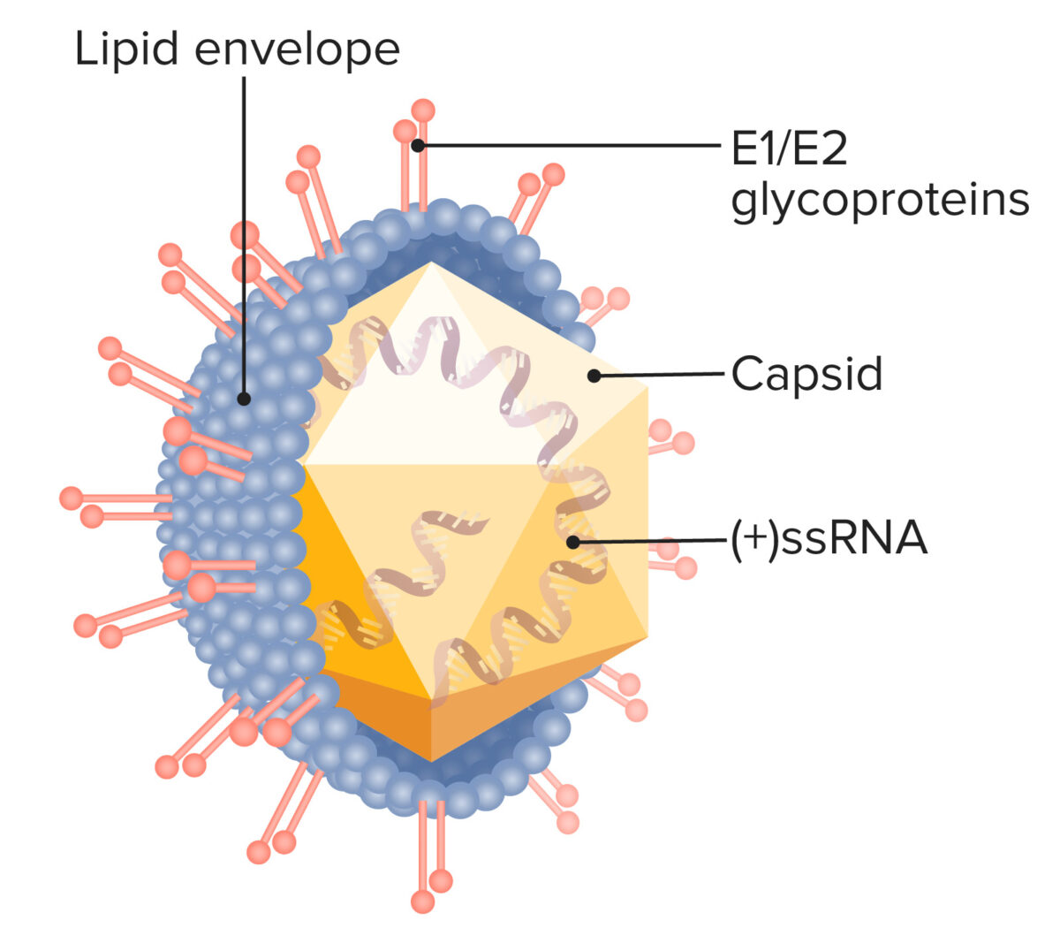
HCV
Family. Flaviviridae
Genera; Hepacivirus
Enveloped virion
Nucleocapsid
(+) ss RNA.
It has no virion polymerase.
Six genotypes.
.

Slide 3
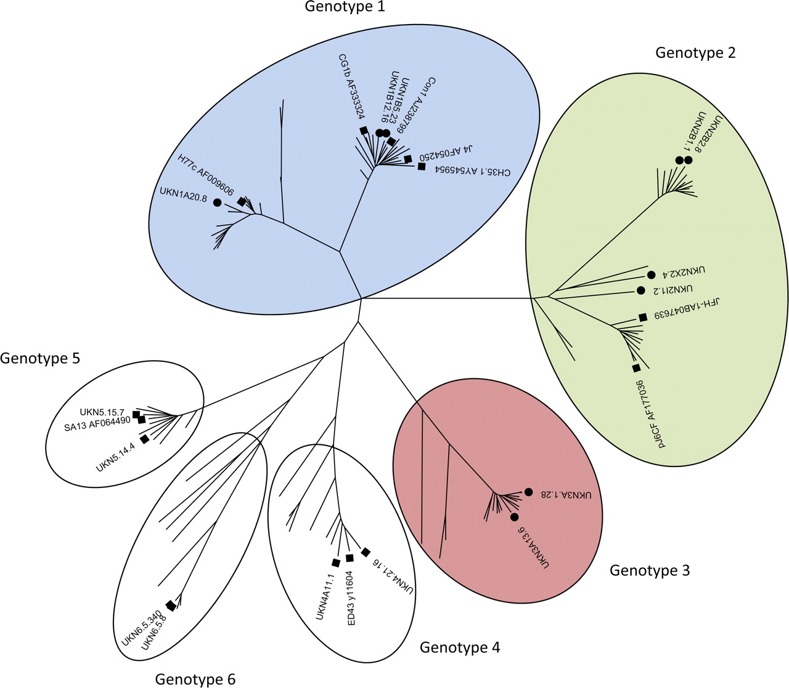
HCV genotypes
The genetic variability is due to the high mutation rate in the envelope gene coupled with the absence of a proofreading function in the virion-encoded RNA polymerase.
Genotype is clinically important in determining potential response to interferon-based therapy and the required duration of such therapy. Genotypes 1 and 4 are less responsive to interferon-based treatment than are the other genotypes (2, 3, 5 and 6)The duration of standard interferon-based therapy for genotypes 1 and 4 is longer.

Slide 4
Transmission & Epidemiology
HCV is transmitted primarily via blood especially sharing needle or other equipment,
Transmission via blood transfusion rarely occurs because donated blood containing antibody to HCV is discarded.
Sexual : rare.
Perinatal

Slide 5
Clinical Findings
Most cases are asymptomatic.
If left untreated progress to cirrhosis and hepatocellular carcinoma.
Acute infection with HCV is milder than infection with HBV.
Chronic carrier state occurs more often with HCV infection than with HBV.

Slide 6
Clinical Findings
The mean incubation period is 8 weeks.
HCV infection also leads to significant autoimmune reactions, including vasculitis, arthralgias, purpura, and glomerulonephritis.

Slide 7
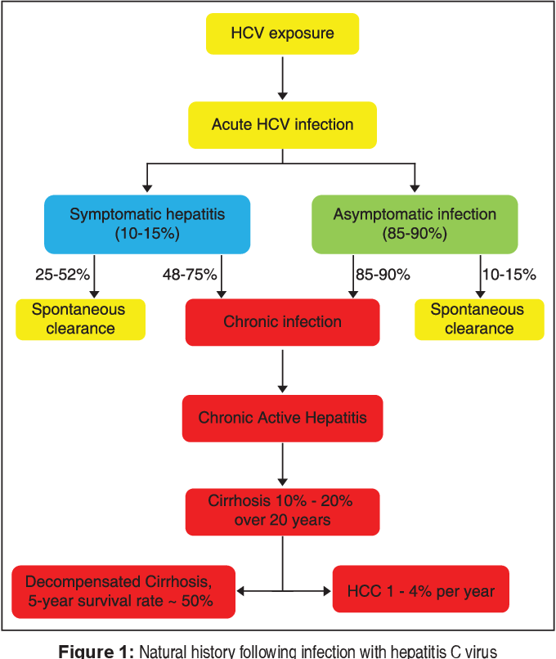

Slide 8
Laboratory Diagnosis
HCV antibodies by(ELISA):The test does not distinguish between IgM and IgG and does not distinguish between an acute, chronic, or resolved infection.
PCR – viral RNA (viral load) in the serum, monitor the success of drug therapy.

Slide 9
Treatment
Acute hepatitis C : peginterferon alfa significantly decreases the number of patients who become chronic carriers.
Chronic hepatitis C: combination of peginterferon alfa-2a, Ribavirin and a protease inhibitor.
In some patients, treatment significantly reduces viral replication, and viral RNA (viral load) becomes undetectable.

Slide 10
Treatment
HCV genotype 1 is less responsive to interferon and ribavirin than are genotypes 2 and 3 and should be treated for longer duration.
The addition of a protease inhibitor, to the combination of peginterferon and ribavirin significantly improved the duration of the suppression of viral replication of HCV genotype 1.

Slide 11
Prevention
No vaccine available
Immune globulin prepration is not useful.
There is no effective regimen for prophylaxis following needle-stick injury; only monitoring is recommended.
Blood found to contain antibody is discarded—a procedure that has prevented virtually all cases of transfusion-acquired HCV infection since 1994.

Slide 12
Prevention
Patients coinfected with HCV and HIV should be prescribed highly active antiretroviral therapy (HAART) with caution because recovery of cell-mediated immunity (immune reconstitution) can result in an exacerbation of hepatitis.
Consideration should be given to treat the HCV infection prior to starting HAART.

Slide 13
Hepatitis D virus

Slide 14
HDV
Defective virus ( cannot replicate by itself because it does not have the genes for its envelope protein).
Replicate only in cells also infected with HBV because HDV uses the surface antigen of HBV (HBsAg) as its envelope protein.
HBV is therefore the helper virus for HDV

Slide 15
HDV
Enveloped virus with (-) ssRNA genome , closed circle.
No virion polymerase.
One serotype because HBsAg has only one serotype.

Slide 16
Transmission & Epidemiology
Same means as is HBV (by blood, sexually, and perinatally), most HDV infections occur in intravenous drug users who share needles.
Worldwide with a similar distribution to that of HBV infections.

Slide 17
Pathogenesis & Immunity
Similar to HBV ( virus-infected hepatocytes are damaged by cytotoxic T cells).
IgG antibody against delta antigen is not detected for long periods after infection; it is therefore uncertain whether long-term immunity to HDV exists.

Slide 18
Clinical Findings
Occurs only in a person infected with HBV.
A person can either be infected with both HDV and HBV at the same time “coinfected” or be previously infected with HBV and then “superinfected” with HDV.

Slide 19
Coinfection with HDV and HBV is more severe than in those infected with HBV alone, but the incidence of chronic hepatitis is about the same in patients infected with HBV alone.
Chronic carriers of HBV who become superinfected with HDV is much more severe, and the incidence of fulminant, life-threatening hepatitis, and liver failure is significantly higher.

Slide 20
Laboratory Diagnosis
The diagnosis of HDV infection in the laboratory is made by detecting either delta antigen or IgM antibody to delta antigen in the patient’s serum

Slide 21
Treatment & Prevention
Peginterferon alfa can reduce some of the effects of the chronic hepatitis caused by HDV but does not eradicate the chronic carrier state.
No specific antiviral therapy against HDV.
No vaccine against HDV, but a person immunized against HBV will not be infected by HDV because HDV cannot replicate unless HBV infection also occurs.

Slide 22
HEPATITIS E VIRUS (HEV)

Slide 23
HEPATITIS E VIRUS (HEV)
Transmitted by the fecal–oral route.
Non enveloped, ssRNA virus.
Hepevirus family.
Clinically resembles hepatitis A, with the exception of a high mortality rate in pregnant women.
Chronic liver disease does not occur, and there is no prolonged carrier state

Slide 24
Diagnosis
The test for HEV antibody is not readily available, the diagnosis is therefore typically made by excluding HAV and other causes.
There is no antiviral treatment and no vaccine.

Slide 25
HEPATITIS G VIRUS (HGV)
GBV-C virus

Slide 26
HEPATITIS G VIRUS (HGV)
In 1996, hepatitis G virus (HGV) was isolated from patients with posttransfusion hepatitis.
Flavivirus family, as is HCV.
However, unlike HCV, which is clearly the cause of both acute hepatitis and chronic active hepatitis and predisposes to hepatocellular carcinoma, HGV has not been documented to cause any of these clinical findings.

Slide 27
The role of HGV is unclear, but it can cause a chronic infection lasting for decades.
HGV is transmitted via sexual intercourse and blood.
Patients coinfected with HIV and HGV have a lower mortality rate and have less HIV in their blood than those infected with HIV alone. It is hypothesized that HGV may interfere with the replication of HIV.

Slide 28
Thank you

